Slide 1
Movements Of Gastrointestinal Tract
Dr. G S Deepa
Assistant Professor
Dept. of Physiology and Biochemistry

Slide 2
CLASSIFICATION
A) Translatory movements :
Movements that propel onwards and propels the food mass
eg:- peristalsis, anti-peristalsis, and mass peristalsis.
B) Stationary movements :
Movements remain localized and do not move onwards.
Present in every part of GIT but not the stationary movements.
eg:- segmentation, tonic contraction

Slide 3
Causes
Neurogenic:
eg: peristalsis and anti-peristalsis
Myogenic :-
eg: segmentation or pendulum

Slide 4
Characteristics
NATURE
FREQUENCY
RATE
CAUSE
FUNCTIONS

Slide 5
Mastication

Slide 6
Mastication
DEFINITION
Cutting the food substances into small particles and grinding them into a soft bolus

Slide 7
SIGNIFICANCE
Breakdown of food stuffs into small particles especially raw veg. and fruits as they have undigestible cellulose memb. around them.
Digestive enzymes can act only on the surfaces of food particles, so rate of digestion depends on surface area
Mixing of food with saliva.
Lubricating and moistening the food with saliva.
Appreciation of taste.

Slide 8
Teeth are designed for chewing
Anterior teeth - Incisors for cutting
Posterior teeth – Molars for grinding

Slide 9
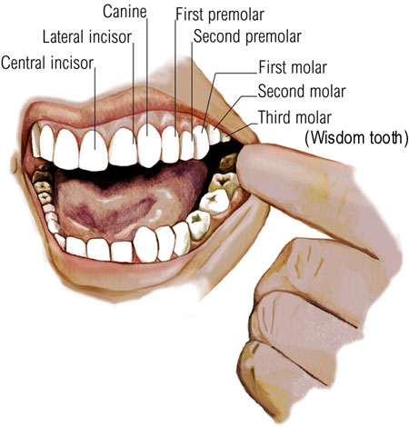
Teeth

Slide 10
MUSCLES OF MASTICATION
Massetor
Temporalis
Pterygoid
Buccinator

Slide 11
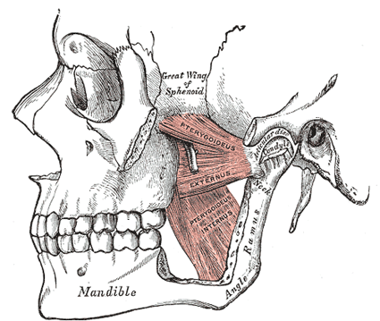

Slide 12
Nervous Regulation
Muscles are supplied by mandibular division of V cranial nerve [trigeminal].
Center for mastication
Medulla and cerebral cortex
Chewing reflex
Bolus of food in mouth initiates reflex inhibition of muscles of mastication

Slide 13
Chewing reflex
Food in mouth
Inhibition of muscles of mastication
Dropping of lower jaw
Initiates stretch reflex in jaw muscles
Rebound contraction
Raises the jaw, closure of mouth
Compresses the bolus against mouth

Slide 14
DEGLUTITION (SWALLOWING)

Slide 15
DEGLUTITION (SWALLOWING)
DEGLUTION OCCURS IN THREE STAGES
ORAL STAGE – Food from mouth enter pharynx
PHARYNGEAL STAGE – Pharynx to esophagus
OESOPHAGEAL STAGE —
Esophagus to stomach

Slide 17
The initial stages of eating and swallowing are under voluntary control. This means that it is governed by the brain.

Slide 18
Once food enters the mouth the teeth break it down into smaller and smaller pieces. This has the dual function of making the food easier to swallow and increasing the surface area of food on which the saliva can act.

Slide 19
The tongue, lips and cheeks assist the teeth in the process by allowing the food to be "rolled" around the oral cavity.
The mechanical action described above produces a softened bolus of food which is now ready to be swallowed. The correct biological term for swallowing is deglutition.

Slide 20
The picture on the left shows the voluntary stage of deglutition. Here the bolus is pushed into the upper part of the pharynx (known as the oropharynx) by the action of the tongue.
The pharyngeal stage of deglutiton is stimulated when the bolus enters the oropharynx. This stage of swallowing is mainly due to a reflex response. Various nerve receptors send messages to the deglutition centre of the brain stem.

Slide 21
This sets off muscular contractions in the pharynx. The soft palate closes off the nasopharynx. The vocal cords in the larynx are moved up and towards the front of the throat thus closing it off to the passage of food. This is extremely important in preventing food from entering the airway.

Slide 22
Another effect of the process is to widen the opening of the oesophagus thus making the passage of the bolus along the alimentary canal easier.
As the bolus pushes it's way into the oesophagus it automatically pushes the epiglottis downwards further closing off the airway.

Slide 23
The bolus then enters the oesophagus and the final stage of swallowing begins.
This final stage is known as the oesophageal stage of deglutiton.

Slide 24
Deglutition Reflex
Though the beginning of swallowing is a voluntary action later it becomes involuntary and carried out by a reflex mechanism known as Deglutition reflex
Bolus in oropharyngeal region
Stimulates the receptors
Afferent impulses from oropharengeal receptors to deglutition center(at the floor of IVth ventricle in medulla)via glossopharyngeal nerve

Slide 25
Deglutition Reflex
Efferent impulses glossopharyngeal (pharyngeal stage) and vagus nerve(esophageal stage)
Reach soft palate pharynx esophagus
Cause upward movement of soft palate,upward movement of larynx,occurance of peristalsis.

Slide 26
DYSPHAGIA
Difficulty in swallowing
CAUSES
First stage:
Inflammation of any oral structure
Paralysis of tongue
congenital defects of any oral structure
Second stage:
acute pharyngitis
tonsillitis
diphtheria

Slide 27
Third stage:
1) Mechanical obstruction
Tumour
Stricture
Diverticular hernia
2) Neurological disorders causing decreased movements of esophagus
eg:- Parkinsonism
3) Muscular disorders

Slide 28
Hiatus Hernia

Slide 29
Achalasia Cardia
Condition in which lower esophageal sphincter fails to relax during swallowing.
Food passage from esophagus to stomach is prevented

Slide 31
Achalasia Cardia
CAUSES
Damage to myentric plexus in lower two thirds of esophagus.
Musculature of esophagus remains spastically contracted.

Slide 32
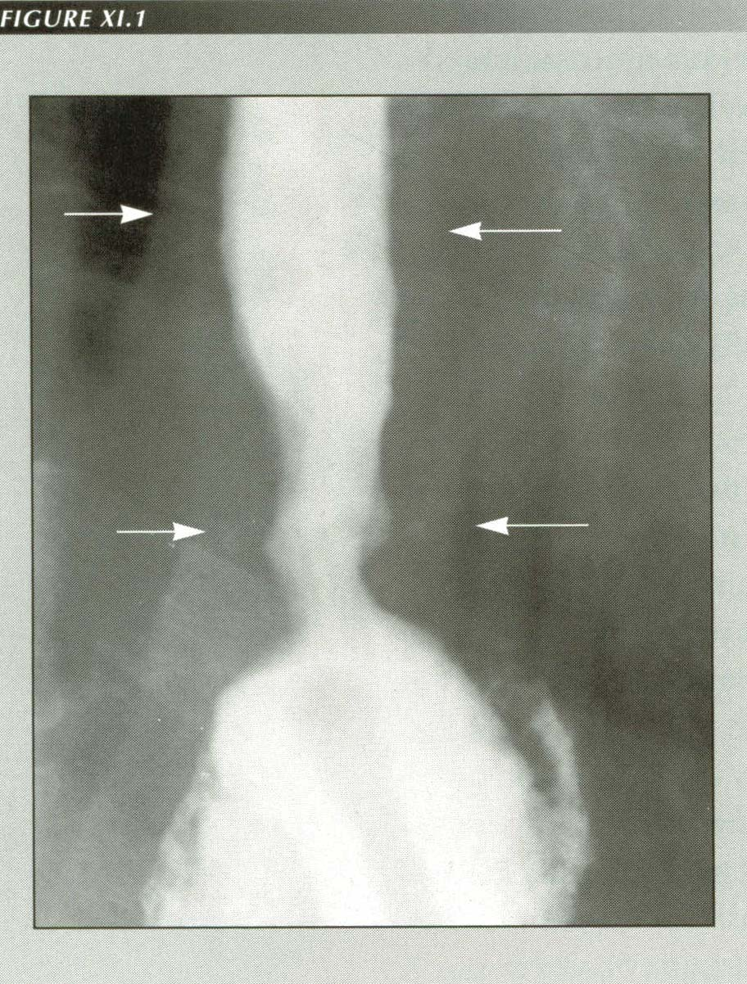

Slide 33
In severe cases, accumulation of food causes enlargement of esophagus until can hold 1 liter of food which become putridly infected
Infection
Ulceration of esophageal mucosa
Severe sub-sternal pain
Rupture

Slide 34
Management
Stretching of lower end of esophagus by means of balloon inflated on the end of a swallowed esophageal tube
Anti-spasmotic drugs

Slide 35
Gastro Esophageal Reflux Disease (GERD)

Slide 36
Gastro Esophageal Reflux Disease (GERD)
Regurgitation of acidic contents into the esophagus
CAUSE:
weakness or incompetence
(Failure to constrict) of lower esophageal sphincter

Slide 37
Gastro Esophageal Reflux Disease
Heart burn or Pyrosis
Dysphagia
Cough and change of voice
Esophageal ulcers or cancer (chronic cases)
FEATURES:

Slide 38
Movements Of Stomach

Slide 39
Movements Of Stomach
IN EMPTY STOMACH
Hunger Contractions
In fasting conditions three types of movements occur

Slide 40
TYPE 1 CONTRACTION
OR TONUS RHYTHM
First contractions appear in the empty stomach when the stomach is empty
Rhythmic contraction occur at the rate of 3 per minute
Lasts for about 20 seconds
Interval between the contractions-3-4 seconds
Pressure produced-5 cm of water

Slide 41
TYPE 2 CONTRACTIONS OR HUNGER CONTRACTION
Occurs when the tonus of stomach is stronger
Lasts for 20 seconds
No interval between contractions
Pressure produced is 10-15 cm of water

Slide 42
TYPE 3 HUNGER CONTRACTION
INCOMPLETE TETANUS
Successive contraction fuse together to cause a continuing tetanic contraction
Occurs when the hunger becomes severe and the tonus increased to great extent
Lasts for 1 to 5 min
Pressure rises to 10 to 20 cm of water
When stomach is empty type 1 contraction occurs followed by type 2 and food intake still postponed type 3 occurs

Slide 43
Hunger contraction more intense in young healthy people who have high degrees of GIT tonus
Also increased by low level of blood sugar
Hunger Pangs:
Pain occurs in the pit of stomach due to hunger contractions
Usually will not occur till 12 to 24 hours after the last ingestion of food, attains greatest intensity in 3 or 4 days and then gradually decreases

Slide 44
Movements after a meal

Slide 45
Movements after a meal
Two different kinds of movements seen in two halves of stomach after the entry of food
Pyloric part has different type of movement than the fundus and body of the stomach

Slide 46
RECEPTIVE RELAXTION OF STOMACH
Relaxation of upper portion of stomach when the bolus enters the stomach from esophagus
It involves fundus and upper part of of body of stomach
Significance: To accommodate food without much increase in pressure inside the stomach

Slide 47
Peristaltic wave
Starts from longitudinal muscle in the greater curvature as a pace maker begin in the mid portion of the stomach wall(mixing waves) and passes over the body, antrum and pylorus at a rate of 3 per minute
Rate of progress 1cm per sec in the muscle of the body and accelerated in the antrum to 3-4 cm per sec
The wave spreads from longitudinal to circular muscle ,more marked distally(antral systole)

Slide 48
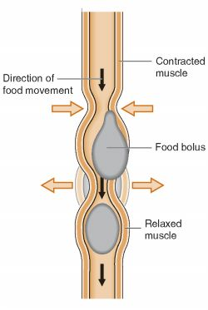

Slide 49
As each wave passes down the antral wall towards pylorus it digs deeply into the food contents in the antrum. Opening of pylorus is still small enough that only a few millimeters or less antral contents are expelled into the duodenum with each wave
As the wave approaches the pylorus the pyloric muscle itself contracts which further impedes emptying through pylorus

Slide 50
Most of the contents are squeezed upstream through peristaltic ring toward body and not toward pylorus
Thus moving peristaltic movement along with this upstream squeezing action called retropulsion is an important mixing movement

Slide 51
Movements of Pylorus
Terminal antrum and the pylorus contract with arrival of wave in their region known as systolic contraction
Due to viscous property of gastric contents and pressing of gastric contents into the terminal part of antrum by the peristaltic wave antral pressure rises which overcome the pressure barriers in pylorus and thus antral contents are passed into duodenum

Slide 52
Factors Influencing the Emptying of Stomach
Volume of gastric content
Gastric emptying is directly propotional to the volume
Consistency of gastric content
Directly proportional to the consistency liquids pass more easily whereas solid will not pass easily unless it is not converted to semi fluid or fluid

Slide 53
Chemical composition
Carbohydrates leave easier than proteins and proteins move easier than fats
PH
strong acid content empty slowly and accelerated by neutralizing it ,thus protecting duodenal mucosa from acidity

Slide 54
Regulation of gastric Emptying
Emptying is mainly regulated by signals from both the stomach and the duodenum.

Slide 55
Gastric factors that promote emptying
Increased food volume increases emptying
Increased food volume
Causes stretching of wall of the stomach
Elicit local myentric reflexes in the wall
Increases the activity of the pyloric pump and slightly inhibit the pylorus

Slide 56
Duodenal factors inhibiting stomach emptying
Entero gastric nervous reflexes from the Duodenum:
Food entering duodenum
Multiple nervous reflexes from duodenal wall
Passes back to stomach
Slows or stop stomach emptying when the volume of chyme in duodenum is too much

Slide 57
Reflexes mediated through three routes:
Duodenum to stomach through enteric nervous system
Through extrinsic nerves
Slight extent through vagus nerve

Slide 58
Factors that can excite enterogastric reflexes:
Degree of distension of duodenum
presence of any degree of irritation of the duodenal mucosa
Degree of acidity of duodenal chyme(>3.5 _4)
Degree of osmolality of the chyme
Presence of certain break down products esp breakdown products of protiens and lesser extent to fat

Slide 59
HORMONAL FACTORS

Slide 60
STIMULUS:
Fat in duodenum
Extract different hormones from duodenal and jejunal epithelium
Blood
Stomach
Inhibit pyloric pump and increase pyloric contraction
FATS

Slide 61
MOST POTENT HORMONES CAUSE HORMONAL FEEDBACK INHIBITION
Cholecystokinin (most important)
Stimulus:Fat
Action:Inhibit stomach motility caused by gastrin
Other Hormones:
Secretin
GIP(Gastric inhibitory peptide)
VIP
PEPTIDE YY
SOMATOSTATIN

Slide 62
VOMITING
DEFINITION:
Vomiting is a reflex which serves to relieve the upper GIT by forcible expulsion of gastric contents through mouth

Slide 63
Causes:
Presence of irritating contents of GIT
Mechanical irritation of pharynx
Pregnancy
Excess alcohol
Nauseating sight,odour or taste
Unusual stimulation of Labyrinthine apparatus as in the case of sea sickness, air sickness, car sickness or swinging
Drugs like antibiotics opiates
Any GI disorder
Acute infections like urinary tract infection
Metabolic disturbances like carbohydrate starvation and ketosis

Slide 64
Mechanism of vomiting
Nausea : Vomiting is always preceded by nausea. Nausea is the unpleasant sensation which induces the desire for vomiting.
Characterized by secretion of large amount of saliva containing more amount of mucus.
Retching : Strong involuntary movements in GIT before actual vomiting and intensify the feeling of vomiting is called retching .
vomiting occurs few minutes after this.

Slide 65
Anti peristalsis , the prelude to vomiting
In early stages of gastrointestinal irritation Antiperistalsis begins to occur often many minutes before vomiting appears.
Antiperistalsis starts in the ileum and travel backwards up the intestine at the rate of 2- 3 cm/sec pushing large amount of intestinal contents back to duodenum and stomach within 3-5 minutes
Over distension of upper portion of GIT especially duodenum becomes the exciting factor that initiates actual vomiting act

Slide 66
At the onset of vomiting strong intrinsic contraction occurs in both the duodenum and stomach along with partial relaxation of lower esophageal sphincter allowing vomitus to move into the esophagus
From here a specific vomiting act involving abdominal muscles takes over and expels the vomitus to exterior

Slide 67
Vomiting act:
Once the vomiting center sufficiently stimulated and the vomiting act instituted the first effects are
1. Deep breath
2. Raising of hyoid bone and larynx to pull the upper esophageal sphincter open
3.Closing of the glottis
4. Lifting of soft palate to close the posterior nares

Slide 68
Next comes the strong downward contraction of diaphragm along with contraction of all the abdominal wall muscles
Squeezes the stomach between diaphragm and abdominal muscles
High intragastric pressure
Complete relaxation of lower esophageal sphincter
Expulsion of gastric contents upward through esophagus

Slide 72
Vomiting reflex:
Irritation or distension of upper part of GIT or other organs
Sensory impulses are carried by vagus and sympathetic afferent nerve fibers
Vomiting center located bilaterally in medulla oblongata near nucleus solitaris
Motor impulses through V, VII,IX,X, and XII cranial nerves
Upper part of GIT
Through Spinal nerves to diaphragm and abdominal muscles

Slide 74
Chemoreceptor trigger zone
Center for vomiting during motion sickness or vomiting induced by drugs like morphine apomorphine etc is on the floor of IVth ventricle
Center for psychic stimuli induced vomiting:
Nauseating odour sight or noise is cerebral cortex

Slide 75
Movements of small intestine

Slide 76
Movements of small intestine
1. Mixing contractions (segmentation contractions)
2. Propulsive contractions (peristalsis)

Slide 77
Movements of small intestine
1. Mixing contractions:
Portion of SI distended with food , stretching of
intestinal wall
Elicit localized concentric contractions spaced at intervals
Divides the intestine into many segments(chain of sausages lasting for a fraction of minute)
Relaxation of contracted sites
New set of contraction at new points between the previous contraction sites causing chopping of the food

Slide 78
CS of Small Intestine

Slide 79
PERISTALTIC MOVEMENT:
A wave of contraction followed by a wave of relaxation
Stimulation of smooth muscles of intestine initiates peristalsis
It travels from point of stimulation to both the directions
But normally that travels in aboral direction persists and to oral direction is inhibited

Slide 80
Starlings law of intestine :
Depending upon the direction of peristalsis Starlings law of intestine is put forward by Starling
The response of the intestine for a local stimulus consists of contraction of smooth muscle above and relaxation below the stimulated area

Slide 81
Peristaltic wave starts at any point of intestine and move anal ward at a velocity of 0.5 to 2.0 cm/sec
Much faster in proximal intestine and much slower in terminal intestine
Normally very weak and usually die after traveling 3-5 cms , very rarely upto 10 cms
So net movement along small intestine normally averages1cm/sec
Thus it takes 3-5 hours for passage of chyme from pylorus to ileocecal valve

Slide 82
Control of peristalsis by nervous and hormonal signals:
Peristalsis greatly increased after a meal
Partly by the entry of chyme and partly by gastroenteric reflex
Gastroenteric reflex:
Distension of stomach
Stimulates Myentric plexus
Impulses carried through the wall of the intestine

Slide 83
Hormonal factors:
Increasing intestinal motility:
Gastrin
CCK
Insulin
Serotonin
Inhibiting intestinal motility:
Secretin
Glucagon

Slide 84
Peristaltic rush:
-Powerful peristaltic contraction caused by excessive irritation of intestinal mucosa or excessive distension
-Begins In duodenum passes the entire length of SI and reaches ileocecal valve within a few minutes
-Sweeps the contents of intestine into the colon relieving the intestine off either irritants or excessive distension

Slide 85
Movements of villi :
These movements are due to contraction of of strips of muscle fibers which proceed from muscularis mucosae and attached to the sides of the villus
Generally two types of movements:
1. Side to side movement
2. Pumping movements

Slide 87
Microscopic villi

Slide 88
Side to side movement:
In these movements villi bent to one side due to contraction of muscle strip on that side
Function:
Admixture
Absorption

Slide 89
Pumping movements:
Muscle strips around the villus contracts simultaneously and the villus shorten in length as a whole
At the height of digestion and abporption the movement takes place at the rate of 1-6 /min
Function:
To increase the flow of bood and lymph

Slide 90
Factors controlling movements of villi:
1. Mechanical irritation of food acting through local nervous plexus
2. Neural stimuli:
Stimulation of sympathetic nerves augments the movements of villi
Stimulationof sympathetic nerves casuses contraction of muscularis mucosae

Slide 91
3. Chemical stimuli:
Products of food digestion esp amino acid
Yeast extracts
4. Villikinin:
It is a hormone that can be extracted from the intestinal mucosa
Structure not definitely known
It is believed that during active digestion it is absorbed through blood and stimulates the movements of villi

Slide 92
Function of ileoceacal valve:
Principle function is to prevent back flow of fecal contents from the colon into small intestine.
The lips of ileocecal valve protrude into the lumen of cecum therefore forcefully closes when excess pressure builds up in the cecum and tries to push cecal contents backward against the lips
The valve usually can resist reverse pressure 50-60 cms of water.

Slide 93
Ileocecal valve has thickened muscular coat called Ileocecal sphincter.
The sphincter normally remains constricted and slows emptying
But after a meal it relaxes as gastroileal reflex intensifies the peristalsis in the ileum
The resistance to emptying prolongs the stay of chyme in the ileum and thereby facilitates absorption
Normally about 1500 ml of chyme empty into cecum every day.

Slide 94
Feed back control of ileo cecal sphincter:
The degree of contraction of ileo cecal sphincter and peristalsis in terminal ileum are controlled by reflexes from cecum

Slide 95
Distension of cecum or any irritation(appendicitis)
Contraction of ileocecal sphincter
Inhibition of ileal peristalsis
Emptying of additional chyme from ileum delayed

Slide 96
Reflexes are mediated by:
Myentric nervous plexus
Extrinsic autonomic nerves( Prevertebral sympathetic ganglia)

Slide 97
Movements of Large Intestine

Slide 99
Movements of Large Intestine
Principle function:
1. Absorption of water and electrolytes from chyme to form solid chyme
2. Storage of fecal matter until it can be expelled
Proximal half- concerned with absorption
Distal half- concerned with storage
As its function does not needs intense movements normally it will be sluggish and can be divided into mixing and propulsive

Slide 100
Mixing movement:
Haustral contraction: bulging of wall of colon in between teniae, reaches its peak in 30 sec and disappears within 60 secs
Propulsive movements:
1. Peristalsis :
Same as in small intestine except in frequency Power of contraction greater in descending
colon due to dry and hard character of the material to be moved

Slide 102
2. Mass peristalsis:
- It is not true peristalsis and it involes large segmants of colon
- First a constrictive ring occurs in response to distended or irritated point usually in transverse colon
- Rapidly there after 20 or more cms of colon distal to constriction lose their haustrations and contract as a unit forcing down the fecal material.

Slide 103
Lasts for 30 secs and then relax for 2-3 min
The whole series persists upto 10-30 min
When they have forced a mass of feces into rectum desire for defecaton occurs
It occurs one to three times a day

Slide 104
Initiation of mass movements:
Facilitated by
Gastro colic reflex Irritation of stomach or
Duodenocolic reflex Distention of duodenum

Slide 105
DEFAECATION
Defaeaction is an act of emptying of entire distal colon from the splenic flexure through the anal orifice into the exterior, which is a reflex process.
Fecal matter stored in sigmod and pelvic colon
Rectum is devoid of feces mostly
1. Partially from the fact a weak functional sphincter exists about 20 cms at the junction between sigmoid colon and rectum
2. Sharp angulation

Slide 106
When a mass movement forces feces into rectum
Desire for defecation occurs
Reflex contraction of rectum and relaxation of anal sphincter
Usually the desire occurs when the pressure rises to20-25 cm H2O-

Slide 107
Anatomy of Anorectum

Slide 108
Ordinarily defecation initiated by defecation reflexes
Intrinsic reflex:
Mediated by Local nervous plexus comparatively very weak
Parasympathetic defecation reflex:
Involves sacral segments of spinal cord is more effective

Slide 109
Continual dribbling of fecal matter through anus is prevented by
1) Internal anal sphincter :
Made up of smooth muscle and innervated by parasympathetic nerve fibers via Pelvic N
2) External anal sphincter:
Composed of skeletal muscle and controlled by somatic N fibers pass through Pudendal N.
It keeps external sphincter constricted always and it relaxes only when it is inhibited

Slide 110
Para sympathetic defecation reflex
Due to mass movement ,feces enters to rectum
Distention of rectum
Sensory nerve endings are stimulated
Impulses transmitted via afferent fibers of pelvic nerve to defecation center (sacral segmants of spinal cord)
Impulse via efferent fibers of pelvic N to descending colon, sigmoid colon and rectum
Cause cantraction and relaxation of internal anal sphincter
Voluntary relaxation of external sphincter due to inhibition of pudendal N arising from cerebral cortex

Slide 111
INTESTINAL GAS
A considerable amount of gas is present in the gastrointestinal contents of all animals, and much of this is eliminated through the anus as flatus.
Five gases constitute greater than 99% of the gases passed as flatus: N₂, O₂, CO₂, H₂ and methane.
None of these gases has an odor, and the characteristic odor of feces is due to very small quantities of a few other gases, including hydrogen sulfide, scatols and indoles.

Slide 112
In normal adult humans, the rate of excretion of gas per rectum ranges between 200 and 2000 ml per day. Ingestion of certain foods, beans being the classical example, is widely recognized to increase the rate of gas production

Slide 113
Constipation:
Failure of voidingof feces
Causes:
dietery
Irregular bowel habit
Spasm of sigmoid colon
Diseases
Dysfunction of myentric plexus- mega colon
Drugs

Slide 114
eas
Thank U All

